Slide 1

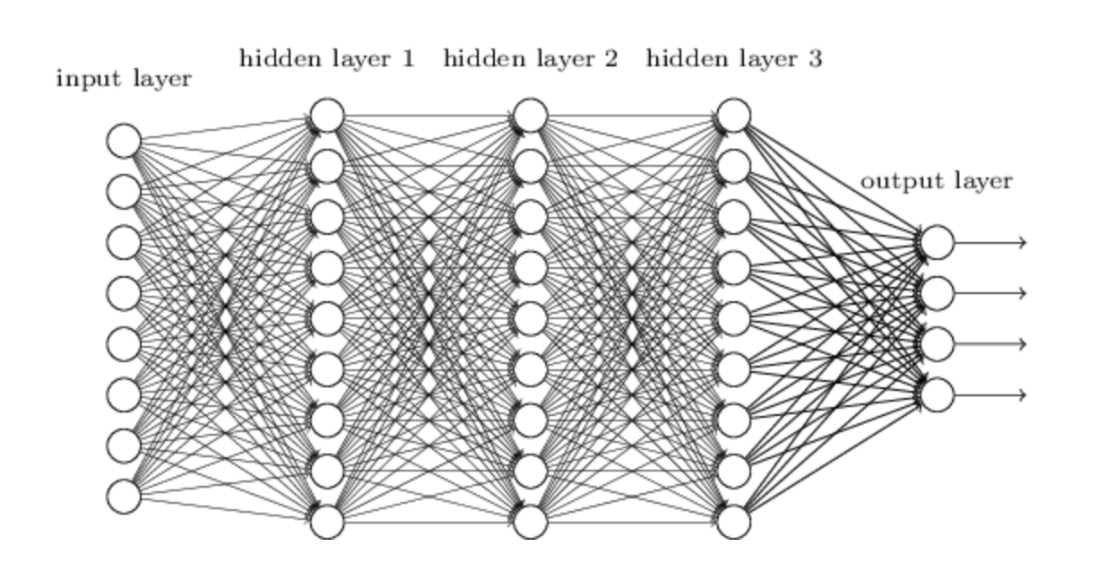
An introduction to supervised learning
https://github.com/cap76/AZCourse_2022

Slide 2
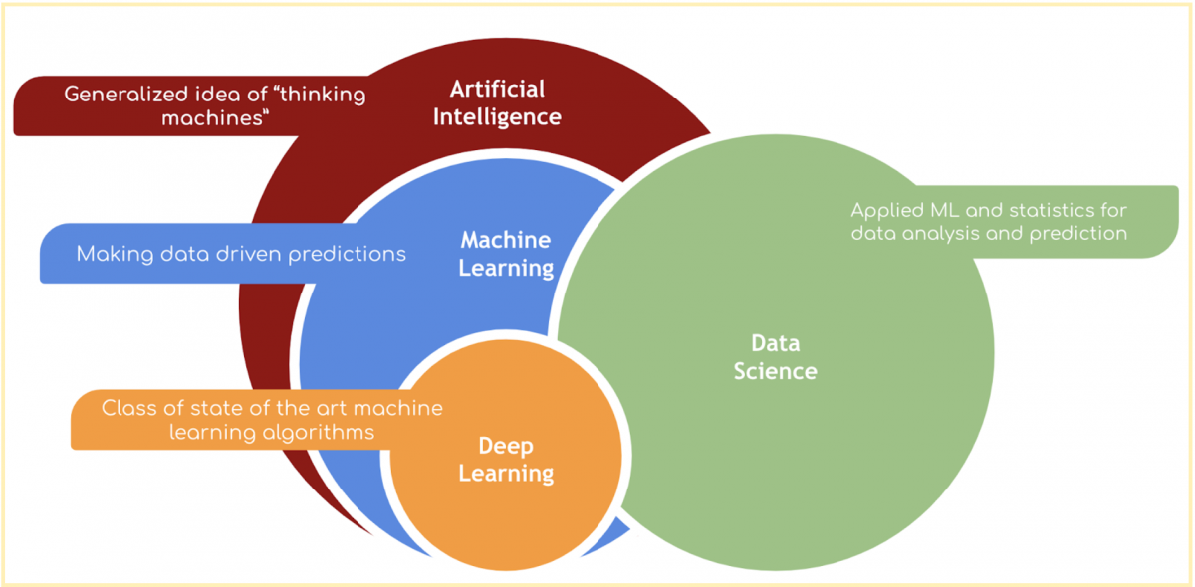
Supervised
Learning
(Good) data
A model of the data
An objective function
Partitioning of the dataset
Predictions & interpretation

Slide 3
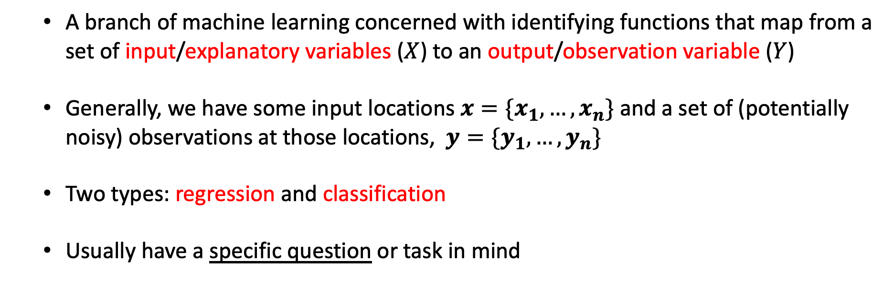
What is supervised learning?
A branch of machine learning concerned with identifying functions that map from a set of input/explanatory variables ($X$) to an output/observation variable ($Y$)
Generally, we have some input locations $x={\{x}_{1},…,x_{n}\}$ and a set of (potentially noisy) observations at those locations, $y={\{y}_{1},…,y_{n}\}$
Two types: regression and classification
Usually have a specific question or task in mind

Slide 4
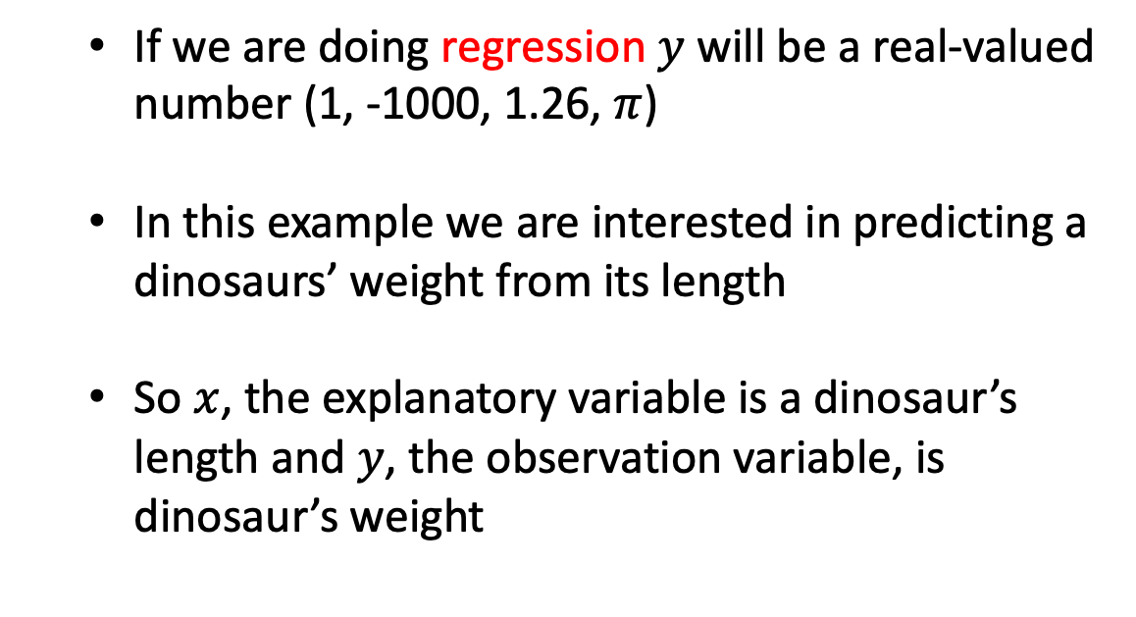
A typical dataset
If we are doing regression $y$ will be a real-valued number (1, -1000, 1.26, $π$)
In this example we are interested in predicting a dinosaurs’ weight from its length
So $x$, the explanatory variable is a dinosaur’s length and $y$, the observation variable, is dinosaur’s weight
Dinosaur | Height (m) | Length (m) | W (kg) | Type
Acrocanthosaurus (top-spined lizard) | 5.8 | 12.2 | 2,722 | Saurischian
Albertosaurus (Alberta lizard) | 4.6 | 9.1 | 2,722 | Saurischian
Allosaurus (other lizard) | 5.2 | 12.2 | 1,814 | Saurischian
Apatosaurus (deceptive lizard) | 4.5 | 22.9 | 29,937 | Saurischian
Archaeopteryx (ancient wing) | 0.3 | 0.9 | 0.9 | Saurischian
Argentinosaurus (Argentina lizard) | 21.4 | 36.6 | 99,792 | Saurischian
Baryonyx (heavy claws) | 1.8 | 9.1 | 1,814 | Saurischian
Brachiosaurus (arm lizard) | 15.2 | 30.5 | 45,360 | Saurischian
Ceratosaurus (horned lizard) | 4 | 6.1 | 1,361 | Saurischian
Coelophysis (hollow form) | 0.9 | 2.7 | 45.5 | Saurischian
Compsognathus (elegant jaw) | 0.6 | 0.9 | 3.6 | Saurischian
Deinonychus (terrible claw) | 1.5 | 2.7 | 80 | Saurischian
Diplodocus (double beam) | 7.3 | 27.1 | 22,680 | Saurischian
Dromiceiomimus (emu mimic) | 1.5 | 3.4 | 100 | Saurischian
Gallimimus (fowlmimic) | 2.4 | 5.5 | 118 | Saurischian
Mamenchisaurus (Mamenchi lizard) | 10.7 | 21 | 27,216 | Saurischian
Megalosaurus (big lizard) | 3.7 | 7.9 | 907 | Saurischian
Microvenator (small hunter) | 0.8 | 1.2 | 6.4 | Saurischian
Ornithomimus (bird mimic) | 2.4 | 4.6 | 136 | Saurischian
Oviraptor (egg robber) | 0.9 | 1.5 | 36 | Saurischian
Plateosaurus (flat lizard) | 2.1 | 7.9 | 1,814 | Saurischian
Saurornithoides (narrow-clawed lizard) | 0.9 | 2 | 27 | Saurischian
Seismosaurus (tremor lizard) | 25.6 | 45.7 | 90,720 | Saurischian
Spinosaurus (spiny lizard) | 2.4 | 12.2 | 6,350 | Saurischian
Supersaurus (super lizard) | 20.1 | 30.5 | 54,432 | Saurischian
Tyrannosaurus (tyrant lizard) | 7 | 15.2 | 6,350 | Saurischian
Ultrasauros (ultra lizard) | 16.2 | 30.5 | 63,504 | Saurischian
Velociraptor (swift robber) | 0.6 | 1.8 | 0.113 | Saurischian
Ankylosaurus (armored lizard) | 2.1 | 10.6 | 4,536 | Ornithischian
Camptosaurus (bent lizard) | 3 | 7 | 1,814 | Ornithischian
Chasmosaurus (cleft lizard) | 1.8 | 5.2 | 1,361 | Ornithischian
Claosaurus (broken lizard) | 1.8 | 3.7 | 907 | Ornithischian
Corythosaurus (helmet lizard) | 4.9 | 9.1 | 4,019 | Ornithischian
Dravidosaurus (Dravidanadu lizard) | 1.2 | 3 | 907 | Ornithischian

Slide 5
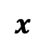
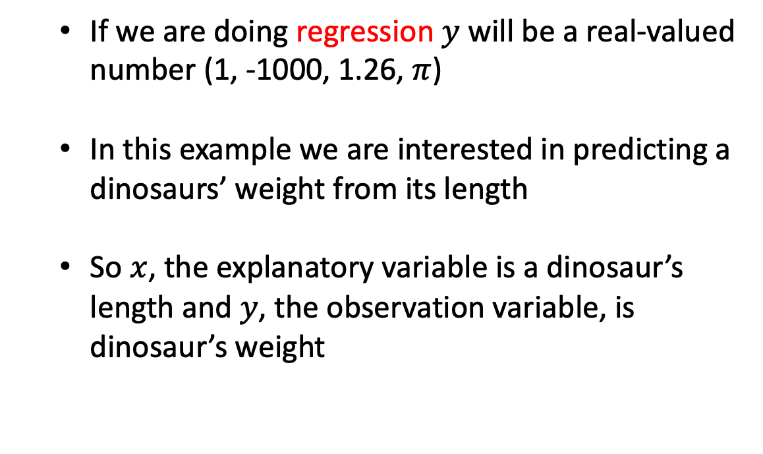
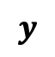
A typical dataset
$$x$$
$$y$$
If we are doing regression $y$ will be a real-valued number (1, -1000, 1.26, $π$)
In this example we are interested in predicting a dinosaurs’ weight from its length
So $x$, the explanatory variable is a dinosaur’s length and $y$, the observation variable, is dinosaur’s weight
Dinosaur | Height (m) | Length (m) | W (kg) | Type
Acrocanthosaurus (top-spined lizard) | 5.8 | 12.2 | 2,722 | Saurischian
Albertosaurus (Alberta lizard) | 4.6 | 9.1 | 2,722 | Saurischian
Allosaurus (other lizard) | 5.2 | 12.2 | 1,814 | Saurischian
Apatosaurus (deceptive lizard) | 4.5 | 22.9 | 29,937 | Saurischian
Archaeopteryx (ancient wing) | 0.3 | 0.9 | 0.9 | Saurischian
Argentinosaurus (Argentina lizard) | 21.4 | 36.6 | 99,792 | Saurischian
Baryonyx (heavy claws) | 1.8 | 9.1 | 1,814 | Saurischian
Brachiosaurus (arm lizard) | 15.2 | 30.5 | 45,360 | Saurischian
Ceratosaurus (horned lizard) | 4 | 6.1 | 1,361 | Saurischian
Coelophysis (hollow form) | 0.9 | 2.7 | 45.5 | Saurischian
Compsognathus (elegant jaw) | 0.6 | 0.9 | 3.6 | Saurischian
Deinonychus (terrible claw) | 1.5 | 2.7 | 80 | Saurischian
Diplodocus (double beam) | 7.3 | 27.1 | 22,680 | Saurischian
Dromiceiomimus (emu mimic) | 1.5 | 3.4 | 100 | Saurischian
Gallimimus (fowlmimic) | 2.4 | 5.5 | 118 | Saurischian
Mamenchisaurus (Mamenchi lizard) | 10.7 | 21 | 27,216 | Saurischian
Megalosaurus (big lizard) | 3.7 | 7.9 | 907 | Saurischian
Microvenator (small hunter) | 0.8 | 1.2 | 6.4 | Saurischian
Ornithomimus (bird mimic) | 2.4 | 4.6 | 136 | Saurischian
Oviraptor (egg robber) | 0.9 | 1.5 | 36 | Saurischian
Plateosaurus (flat lizard) | 2.1 | 7.9 | 1,814 | Saurischian
Saurornithoides (narrow-clawed lizard) | 0.9 | 2 | 27 | Saurischian
Seismosaurus (tremor lizard) | 25.6 | 45.7 | 90,720 | Saurischian
Spinosaurus (spiny lizard) | 2.4 | 12.2 | 6,350 | Saurischian
Supersaurus (super lizard) | 20.1 | 30.5 | 54,432 | Saurischian
Tyrannosaurus (tyrant lizard) | 7 | 15.2 | 6,350 | Saurischian
Ultrasauros (ultra lizard) | 16.2 | 30.5 | 63,504 | Saurischian
Velociraptor (swift robber) | 0.6 | 1.8 | 0.113 | Saurischian
Ankylosaurus (armored lizard) | 2.1 | 10.6 | 4,536 | Ornithischian
Camptosaurus (bent lizard) | 3 | 7 | 1,814 | Ornithischian
Chasmosaurus (cleft lizard) | 1.8 | 5.2 | 1,361 | Ornithischian
Claosaurus (broken lizard) | 1.8 | 3.7 | 907 | Ornithischian
Corythosaurus (helmet lizard) | 4.9 | 9.1 | 4,019 | Ornithischian
Dravidosaurus (Dravidanadu lizard) | 1.2 | 3 | 907 | Ornithischian

Slide 6
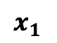
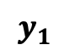
A typical dataset
$$x_{1}$$
$$y_{1}$$
If we are doing regression $y$ will be a real-valued number (1, -1000, 1.26, $π$)
In this example we are interested in predicting a dinosaurs’ weight from its length
So $x$, the explanatory variable is a dinosaur’s length and $y$, the observation variable, is dinosaur’s weight
Dinosaur | Height (m) | Length (m) | W (kg) | Type
Acrocanthosaurus (top-spined lizard) | 5.8 | 12.2 | 2,722 | Saurischian
Albertosaurus (Alberta lizard) | 4.6 | 9.1 | 2,722 | Saurischian
Allosaurus (other lizard) | 5.2 | 12.2 | 1,814 | Saurischian
Apatosaurus (deceptive lizard) | 4.5 | 22.9 | 29,937 | Saurischian
Archaeopteryx (ancient wing) | 0.3 | 0.9 | 0.9 | Saurischian
Argentinosaurus (Argentina lizard) | 21.4 | 36.6 | 99,792 | Saurischian
Baryonyx (heavy claws) | 1.8 | 9.1 | 1,814 | Saurischian
Brachiosaurus (arm lizard) | 15.2 | 30.5 | 45,360 | Saurischian
Ceratosaurus (horned lizard) | 4 | 6.1 | 1,361 | Saurischian
Coelophysis (hollow form) | 0.9 | 2.7 | 45.5 | Saurischian
Compsognathus (elegant jaw) | 0.6 | 0.9 | 3.6 | Saurischian
Deinonychus (terrible claw) | 1.5 | 2.7 | 80 | Saurischian
Diplodocus (double beam) | 7.3 | 27.1 | 22,680 | Saurischian
Dromiceiomimus (emu mimic) | 1.5 | 3.4 | 100 | Saurischian
Gallimimus (fowlmimic) | 2.4 | 5.5 | 118 | Saurischian
Mamenchisaurus (Mamenchi lizard) | 10.7 | 21 | 27,216 | Saurischian
Megalosaurus (big lizard) | 3.7 | 7.9 | 907 | Saurischian
Microvenator (small hunter) | 0.8 | 1.2 | 6.4 | Saurischian
Ornithomimus (bird mimic) | 2.4 | 4.6 | 136 | Saurischian
Oviraptor (egg robber) | 0.9 | 1.5 | 36 | Saurischian
Plateosaurus (flat lizard) | 2.1 | 7.9 | 1,814 | Saurischian
Saurornithoides (narrow-clawed lizard) | 0.9 | 2 | 27 | Saurischian
Seismosaurus (tremor lizard) | 25.6 | 45.7 | 90,720 | Saurischian
Spinosaurus (spiny lizard) | 2.4 | 12.2 | 6,350 | Saurischian
Supersaurus (super lizard) | 20.1 | 30.5 | 54,432 | Saurischian
Tyrannosaurus (tyrant lizard) | 7 | 15.2 | 6,350 | Saurischian
Ultrasauros (ultra lizard) | 16.2 | 30.5 | 63,504 | Saurischian
Velociraptor (swift robber) | 0.6 | 1.8 | 0.113 | Saurischian
Ankylosaurus (armored lizard) | 2.1 | 10.6 | 4,536 | Ornithischian
Camptosaurus (bent lizard) | 3 | 7 | 1,814 | Ornithischian
Chasmosaurus (cleft lizard) | 1.8 | 5.2 | 1,361 | Ornithischian
Claosaurus (broken lizard) | 1.8 | 3.7 | 907 | Ornithischian
Corythosaurus (helmet lizard) | 4.9 | 9.1 | 4,019 | Ornithischian
Dravidosaurus (Dravidanadu lizard) | 1.2 | 3 | 907 | Ornithischian

Slide 7
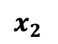
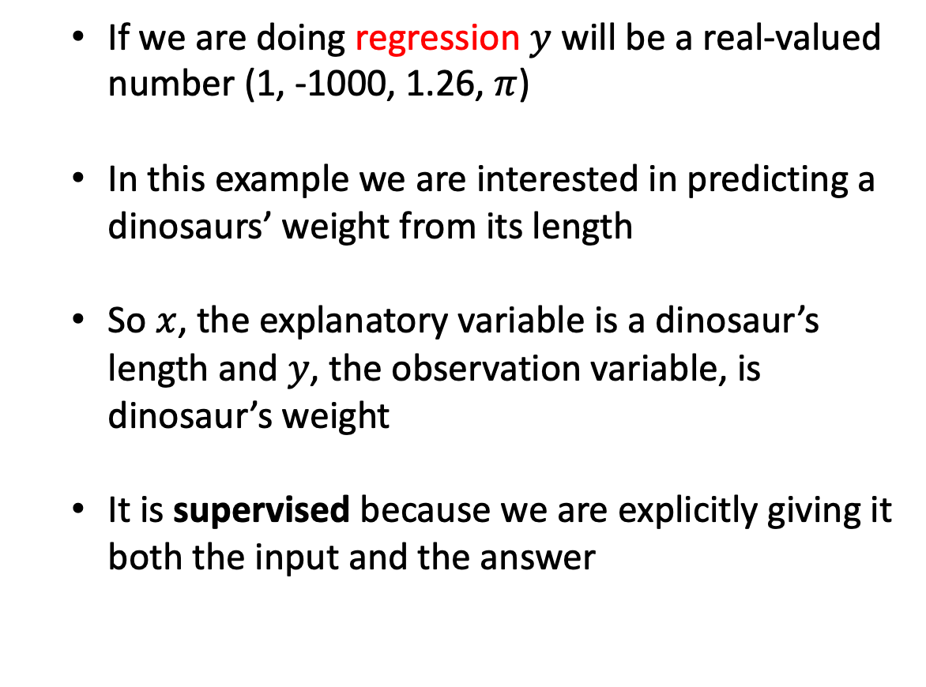
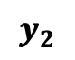
A typical dataset
$$x_{2}$$
$$y_{2}$$
If we are doing regression $y$ will be a real-valued number (1, -1000, 1.26, $π$)
In this example we are interested in predicting a dinosaurs’ weight from its length
So $x$, the explanatory variable is a dinosaur’s length and $y$, the observation variable, is dinosaur’s weight
It is supervised because we are explicitly giving it both the input and the answer
Dinosaur | Height (m) | Length (m) | W (kg) | Type
Acrocanthosaurus (top-spined lizard) | 5.8 | 12.2 | 2,722 | Saurischian
Albertosaurus (Alberta lizard) | 4.6 | 9.1 | 2,722 | Saurischian
Allosaurus (other lizard) | 5.2 | 12.2 | 1,814 | Saurischian
Apatosaurus (deceptive lizard) | 4.5 | 22.9 | 29,937 | Saurischian
Archaeopteryx (ancient wing) | 0.3 | 0.9 | 0.9 | Saurischian
Argentinosaurus (Argentina lizard) | 21.4 | 36.6 | 99,792 | Saurischian
Baryonyx (heavy claws) | 1.8 | 9.1 | 1,814 | Saurischian
Brachiosaurus (arm lizard) | 15.2 | 30.5 | 45,360 | Saurischian
Ceratosaurus (horned lizard) | 4 | 6.1 | 1,361 | Saurischian
Coelophysis (hollow form) | 0.9 | 2.7 | 45.5 | Saurischian
Compsognathus (elegant jaw) | 0.6 | 0.9 | 3.6 | Saurischian
Deinonychus (terrible claw) | 1.5 | 2.7 | 80 | Saurischian
Diplodocus (double beam) | 7.3 | 27.1 | 22,680 | Saurischian
Dromiceiomimus (emu mimic) | 1.5 | 3.4 | 100 | Saurischian
Gallimimus (fowlmimic) | 2.4 | 5.5 | 118 | Saurischian
Mamenchisaurus (Mamenchi lizard) | 10.7 | 21 | 27,216 | Saurischian
Megalosaurus (big lizard) | 3.7 | 7.9 | 907 | Saurischian
Microvenator (small hunter) | 0.8 | 1.2 | 6.4 | Saurischian
Ornithomimus (bird mimic) | 2.4 | 4.6 | 136 | Saurischian
Oviraptor (egg robber) | 0.9 | 1.5 | 36 | Saurischian
Plateosaurus (flat lizard) | 2.1 | 7.9 | 1,814 | Saurischian
Saurornithoides (narrow-clawed lizard) | 0.9 | 2 | 27 | Saurischian
Seismosaurus (tremor lizard) | 25.6 | 45.7 | 90,720 | Saurischian
Spinosaurus (spiny lizard) | 2.4 | 12.2 | 6,350 | Saurischian
Supersaurus (super lizard) | 20.1 | 30.5 | 54,432 | Saurischian
Tyrannosaurus (tyrant lizard) | 7 | 15.2 | 6,350 | Saurischian
Ultrasauros (ultra lizard) | 16.2 | 30.5 | 63,504 | Saurischian
Velociraptor (swift robber) | 0.6 | 1.8 | 0.113 | Saurischian
Ankylosaurus (armored lizard) | 2.1 | 10.6 | 4,536 | Ornithischian
Camptosaurus (bent lizard) | 3 | 7 | 1,814 | Ornithischian
Chasmosaurus (cleft lizard) | 1.8 | 5.2 | 1,361 | Ornithischian
Claosaurus (broken lizard) | 1.8 | 3.7 | 907 | Ornithischian
Corythosaurus (helmet lizard) | 4.9 | 9.1 | 4,019 | Ornithischian
Dravidosaurus (Dravidanadu lizard) | 1.2 | 3 | 907 | Ornithischian

Slide 8
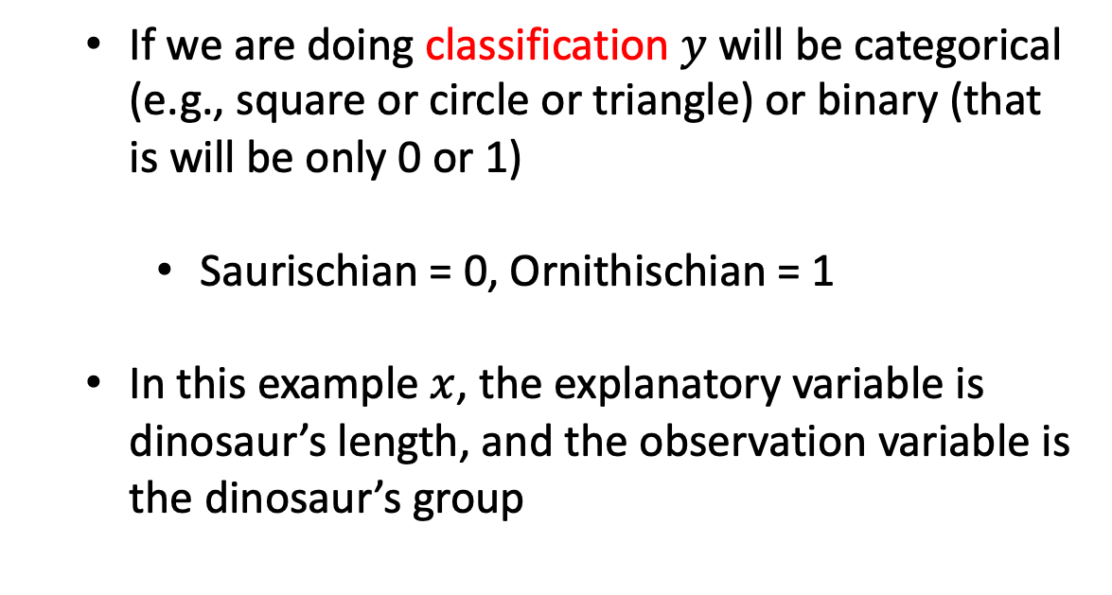
A typical dataset
$$x$$
$$y$$
If we are doing classification $y$ will be categorical (e.g., square or circle or triangle) or binary (that is will be only 0 or 1)
Saurischian = 0, Ornithischian = 1
In this example $x$, the explanatory variable is dinosaur’s length, and the observation variable is the dinosaur’s group
Dinosaur | Height (m) | Length (m) | W (kg) | Type
Acrocanthosaurus (top-spined lizard) | 5.8 | 12.2 | 2,722 | Saurischian
Albertosaurus (Alberta lizard) | 4.6 | 9.1 | 2,722 | Saurischian
Allosaurus (other lizard) | 5.2 | 12.2 | 1,814 | Saurischian
Apatosaurus (deceptive lizard) | 4.5 | 22.9 | 29,937 | Saurischian
Archaeopteryx (ancient wing) | 0.3 | 0.9 | 0.9 | Saurischian
Argentinosaurus (Argentina lizard) | 21.4 | 36.6 | 99,792 | Saurischian
Baryonyx (heavy claws) | 1.8 | 9.1 | 1,814 | Saurischian
Brachiosaurus (arm lizard) | 15.2 | 30.5 | 45,360 | Saurischian
Ceratosaurus (horned lizard) | 4 | 6.1 | 1,361 | Saurischian
Coelophysis (hollow form) | 0.9 | 2.7 | 45.5 | Saurischian
Compsognathus (elegant jaw) | 0.6 | 0.9 | 3.6 | Saurischian
Deinonychus (terrible claw) | 1.5 | 2.7 | 80 | Saurischian
Diplodocus (double beam) | 7.3 | 27.1 | 22,680 | Saurischian
Dromiceiomimus (emu mimic) | 1.5 | 3.4 | 100 | Saurischian
Gallimimus (fowlmimic) | 2.4 | 5.5 | 118 | Saurischian
Mamenchisaurus (Mamenchi lizard) | 10.7 | 21 | 27,216 | Saurischian
Megalosaurus (big lizard) | 3.7 | 7.9 | 907 | Saurischian
Microvenator (small hunter) | 0.8 | 1.2 | 6.4 | Saurischian
Ornithomimus (bird mimic) | 2.4 | 4.6 | 136 | Saurischian
Oviraptor (egg robber) | 0.9 | 1.5 | 36 | Saurischian
Plateosaurus (flat lizard) | 2.1 | 7.9 | 1,814 | Saurischian
Saurornithoides (narrow-clawed lizard) | 0.9 | 2 | 27 | Saurischian
Seismosaurus (tremor lizard) | 25.6 | 45.7 | 90,720 | Saurischian
Spinosaurus (spiny lizard) | 2.4 | 12.2 | 6,350 | Saurischian
Supersaurus (super lizard) | 20.1 | 30.5 | 54,432 | Saurischian
Tyrannosaurus (tyrant lizard) | 7 | 15.2 | 6,350 | Saurischian
Ultrasauros (ultra lizard) | 16.2 | 30.5 | 63,504 | Saurischian
Velociraptor (swift robber) | 0.6 | 1.8 | 0.113 | Saurischian
Ankylosaurus (armored lizard) | 2.1 | 10.6 | 4,536 | Ornithischian
Camptosaurus (bent lizard) | 3 | 7 | 1,814 | Ornithischian
Chasmosaurus (cleft lizard) | 1.8 | 5.2 | 1,361 | Ornithischian
Claosaurus (broken lizard) | 1.8 | 3.7 | 907 | Ornithischian
Corythosaurus (helmet lizard) | 4.9 | 9.1 | 4,019 | Ornithischian
Dravidosaurus (Dravidanadu lizard) | 1.2 | 3 | 907 | Ornithischian

Slide 9
What is supervised learning?
Why are we interested in finding a relationships between an observation variable and several explanatory variables?
Often explanatory variables are cheaper/easier to measure but we’re interested in is the observation variable
Allow us to make predictions at new locations (forecasting, decision making)
Allow us to distinguish between models (model structure, hypothesis testing, insight)
This function itself can tell us something about the nature of the system (linear, exponential, circadian, or which variables are important)

Slide 10
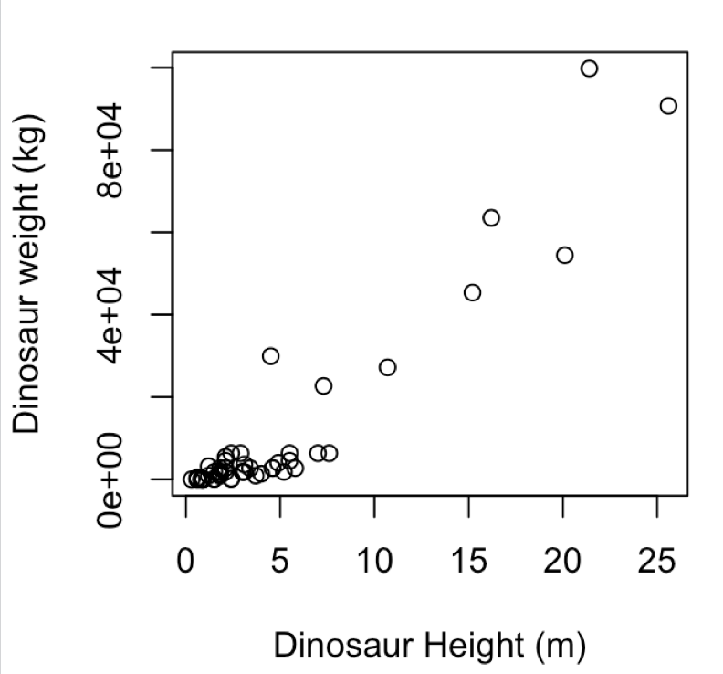
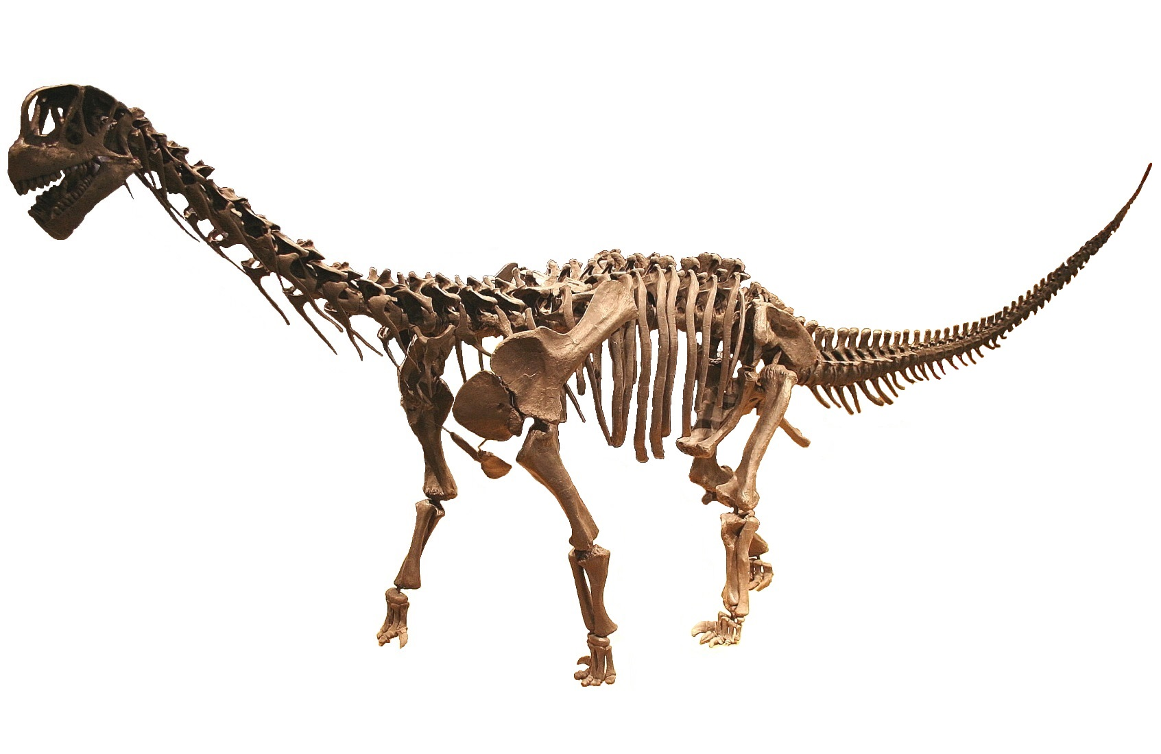
A model
How do we quantify this relationship?
First we need a model
Something that captures our expectation about the relationships
Predict at new locations
Usually has some parameters
data/Dinosaurs.csv

Slide 11
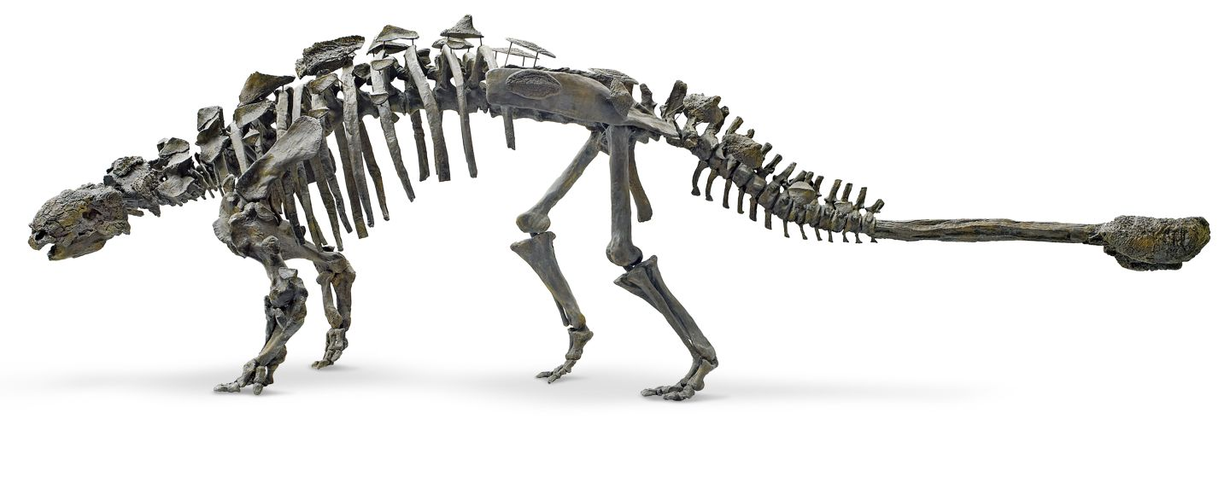
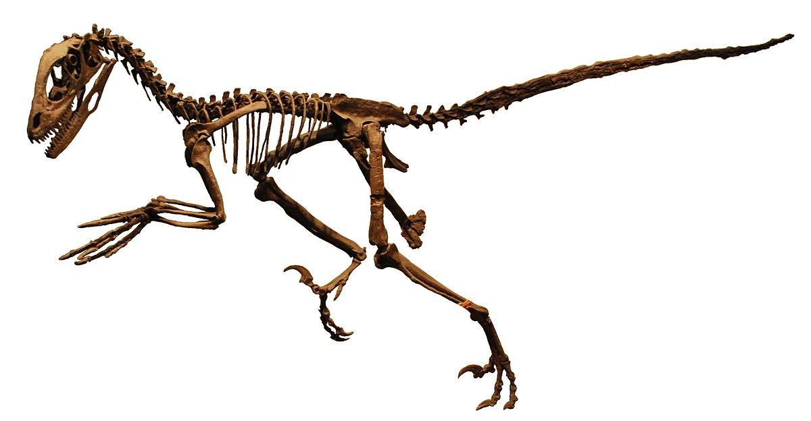
What is linear regression?
How do we quantify this relationship?
When m = 0 we have a flat line
When c = 0 we have a line that passes through (0,0).
intercept
y = m x + c
gradient

Slide 12
What is linear regression?
How do we quantify this relationship?
m
y = m x + c
c = 0, m = (1000-0)/(25-0)
c
y = 40 x + 0

Slide 13
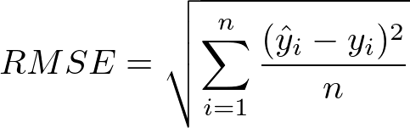
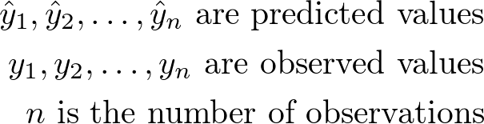
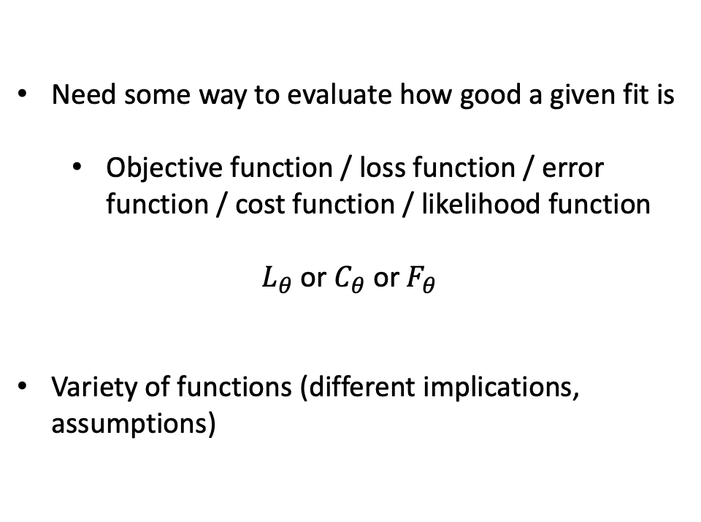
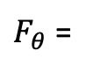
An objective function
Need some way to evaluate how good a given fit is
Objective function / loss function / error function / cost function / likelihood function
$L_{θ}$ or $C_{θ}$or $F_{θ}$
Variety of functions (different implications, assumptions)
$F_{θ}$ =

Slide 14

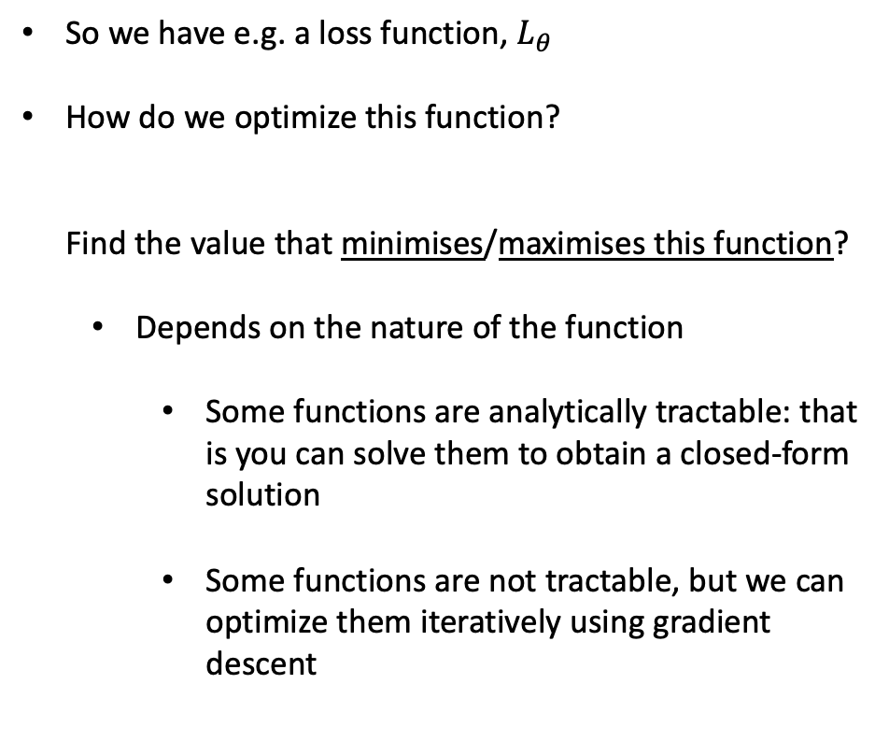
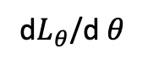
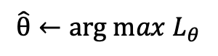
Need a way to optimise
So we have e.g. a loss function, $L_{θ}$
How do we optimize this function? Find the value that minimises/maximises this function?
Depends on the nature of the function
Some functions are analytically tractable: that is you can solve them to obtain a closed-form solution
Some functions are not tractable, but we can optimize them iteratively using gradient descent
$$\hat{θ}←arg max{ L}_{θ}$$
d$L_{θ}$/d $θ$
https://blog.paperspace.com/intro-to-optimization-in-deep-learning-gradient-descent/

Slide 15
Need a way to optimise
Some functions will be highly multimodal
Gradient search doesn’t necessarily find the best value
Parameter spaces can be very large

Slide 16
What is linear regression?

Slide 17

Training set/test set
Break data down into training and test sets
60/40 – 80/20 split
Save the hold out data to evaluate the model or to compare different models
In training data use k-fold cross validation
Typical 5/10-fold cross validation
Robustness and uncertainty
Sometimes even training/validation/test sets
70/20/10

Slide 18
Observation variable
Explanatory variable

Slide 19
Randomly select a training set

Slide 20
SSE
Try different values of (m, c) and evaluate the sum squared error (SSE):
∑ ( (y_{pred} – y_{observed})² )
(here we fix c to the true value and just look at varying m)
m

Slide 25
This model is slightly worse than the previous one

Slide 27
What is linear regression?
Is analytically tractable (can solve it to find the value in terms of an equation)
Can predict the values of y* at new location x* (forecasting/decision making)
In this case the best model (minimizing SSE) doesn’t do so well for larger dinosaurs

Slide 28
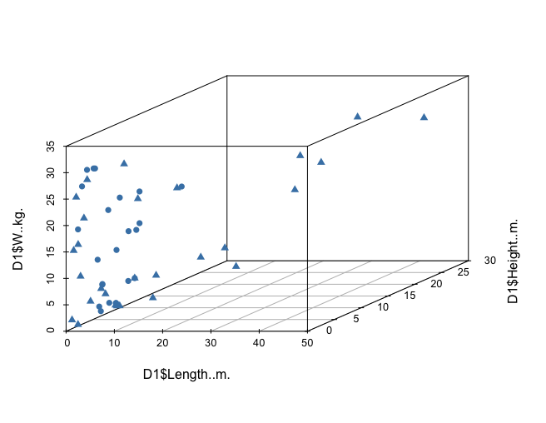
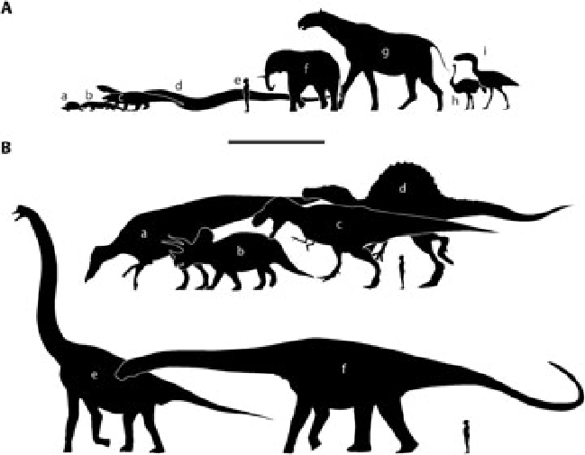
`
Multiple explanatory variables
Dinosaur weight (kg)
Dinosaur height (m)
Dinosaur length (m)
z = m₁ x + m₂ y + c
Our model for z is a linear combination of input variables
R PSEUDOCODE
If m₁ is small than the variable x doesn’t have much of an impact on inference
lrfit <- train(z ~ x + y, data, method = "lm")

Slide 29
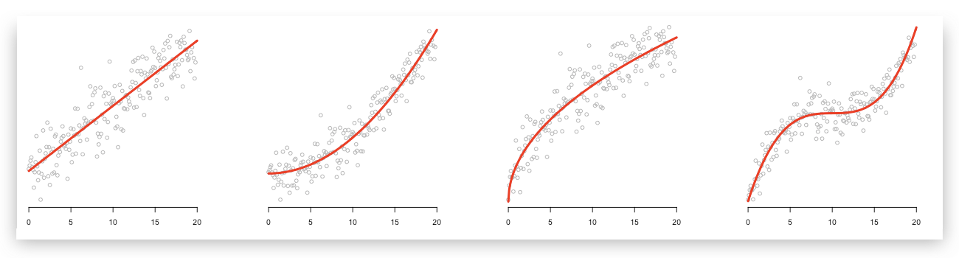
Beyond linear regression
m
c
R PSEUDOCODE
y = m x + c
lrfit <- train(y~., x, method = "lm")

Slide 30
Polynomial regression
y = m₁ x² + m₂ x + c
R PSEUDOCODE
y = m₃ x³ m₂ x² + m₁ x + c
lrfit <- train(y~poly(x,degree=3), data, method = "lm")
y = ∑ m_{i} x^{i} + c

Slide 31
Evaluating performance

Slide 32
Evaluating performance
Underfitting
Over-fitting

Slide 33
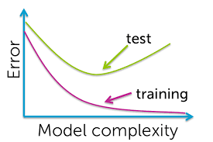
Evaluating performance

Slide 34
What about classification?

Slide 35
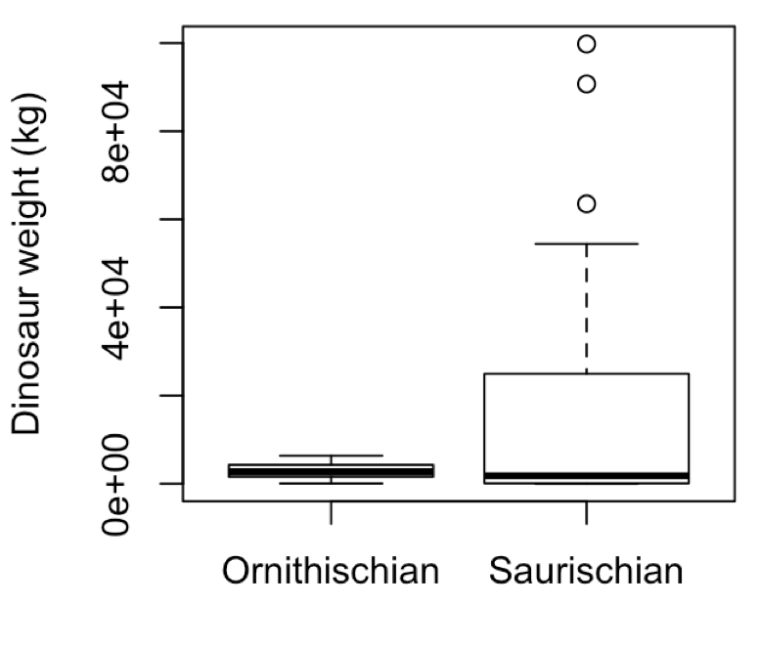
Logistic regression
Logistic regression
Is there a relationship between a dinosaur’s size and its (sub)order? Can we predict the the dinosaurs order given just measurement of its size?

Slide 36
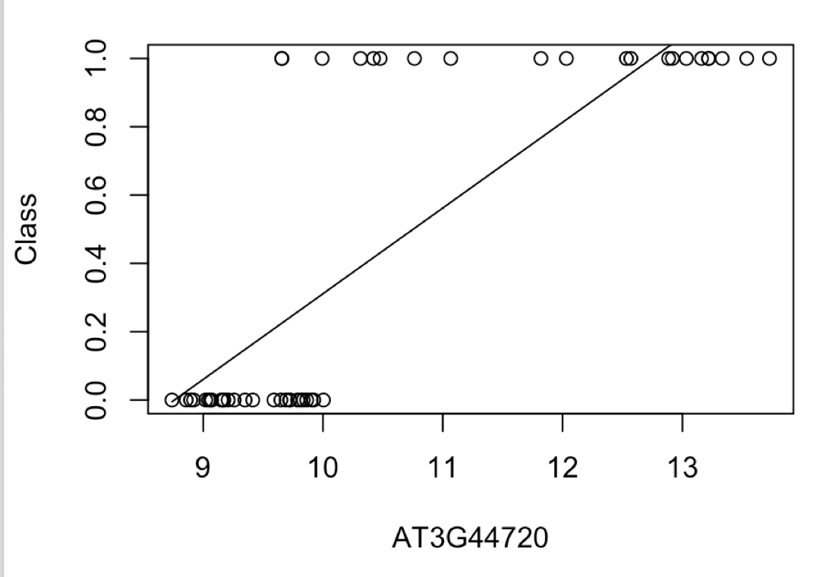
Logistic regression
Explanatory variable x is continuous, but we have binary valued outputs, y
Linear/polynomial regression is no good!
Need a model that correctly accounts for the type of data we have
Suborder
Dinosaur weight/height/length

Slide 37
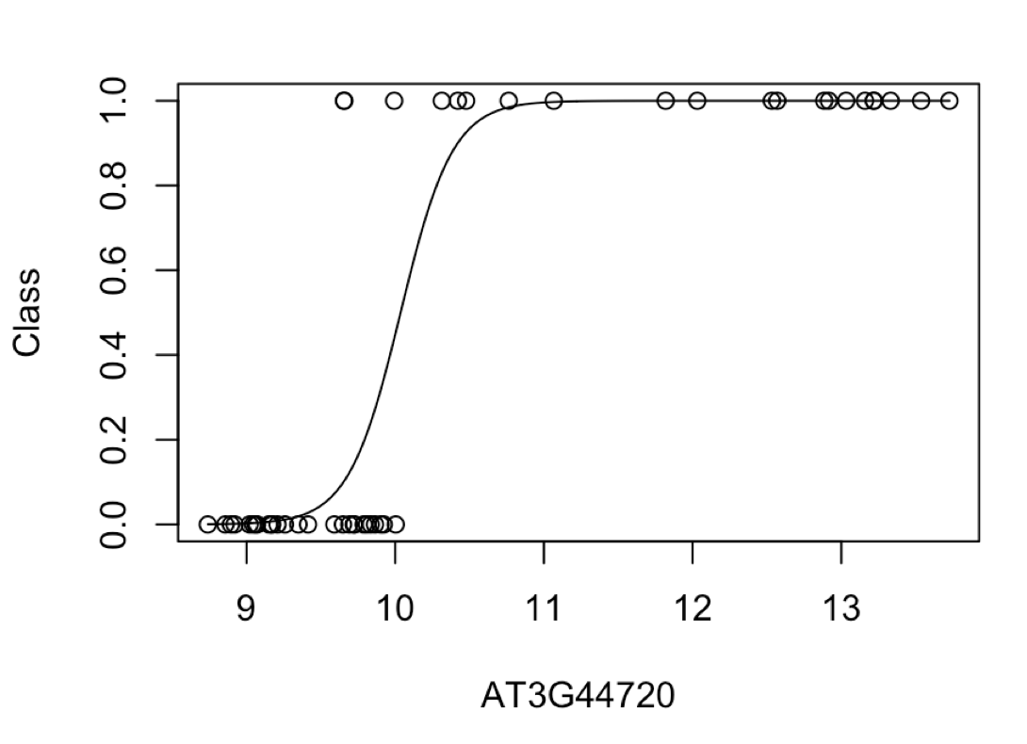
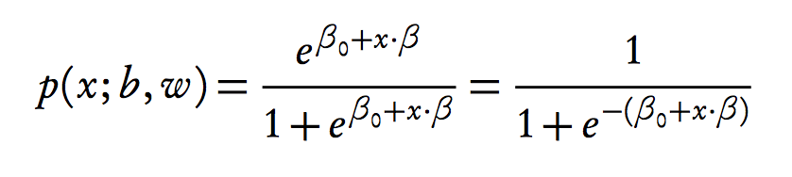
Logistic regression
Model the probability of success using a logistic function

Slide 38
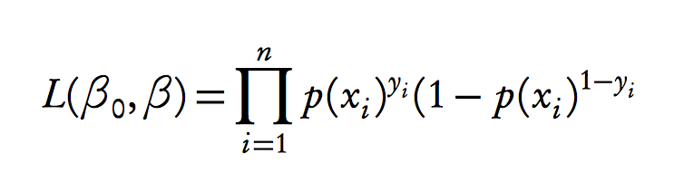
Logistic regression
Model the probability of success using a logistic function
Likelihood
)
R PSEUDOCODE
lrfit <- train(y ~ x, data, method="glm", family="binomial")
Using held out data find parameters that maximises this
likelihood

Slide 39
Logistic regression
Likelihood
)
Other values for betas?

Slide 40
Logistic regression

Slide 41
Logistic regression
R PSEUDOCODE
lrfit <- train(y ~ x + z, data, method="glm", family="binomial")
Multiple input variables

Slide 42
Evaluating performance
Evaluating using sum of squared error is a poor choice for performance.
Count number of correct/incorrect classifications
True positive: Predict y = 1 and observation y = 1.
True negative: Predict y = 0 and observation y = 0.
False positive: Predict y = 1 and observation y = 0.
False negative: Predict y = 0 and observation y = 1.

Slide 43
Receiver operating characteristics (ROC)
Try a range of different thresholds
Plot false positive rate (FPR) versus true positive rate (TPR).
Receiver operating characteristic curve

Slide 44
ROC
TPR = TP/(TP+FN)
Sensitivity
FPR = FP/(FP+TN)
Fallout

Slide 45
ROC
TPR = TP/(TP+FN)
Sensitivity
FPR = FP/(FP+TN)
Fallout

Slide 46
ROC
AUC = 1 (perfect classification)
AUC = 0.5 (random classification)
TPR = TP/(TP+FN)
Sensitivity
FPR = FP/(FP+TN)
Fallout

Slide 47

Repeatability?
In many cases ML has a strong empirical emphasis (statistics still playing catch up)
Need to ensure work is repeatable. How?
Available data
Open-source code: GitHub or other repositories
Documenting codebase (version control or Docker)
Setting the (pseudo) random number generators (setting the seed)
A pseudo-random number generator is an endlessly repeating fixed list of numbers.

Slide 48
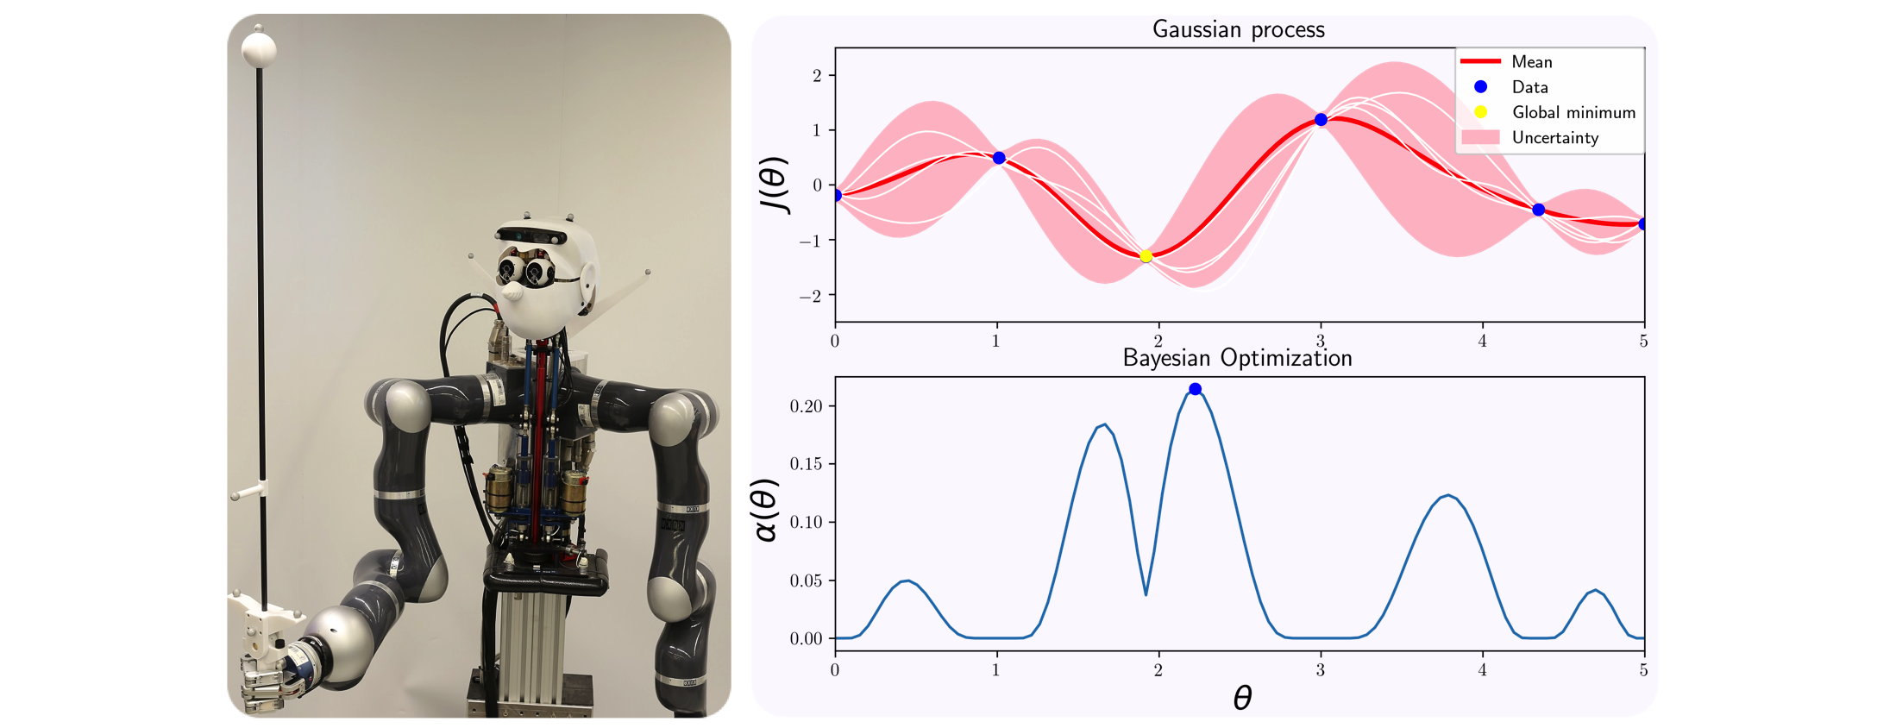
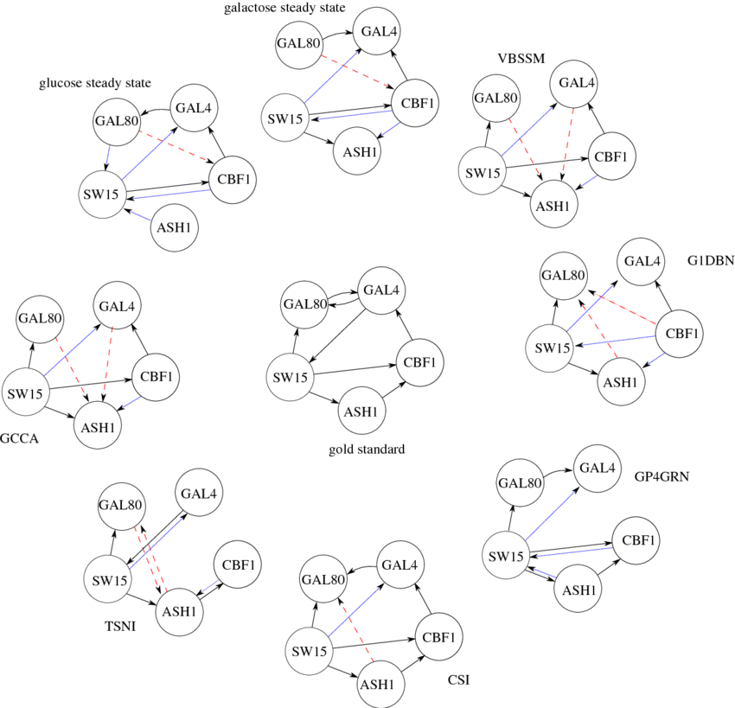
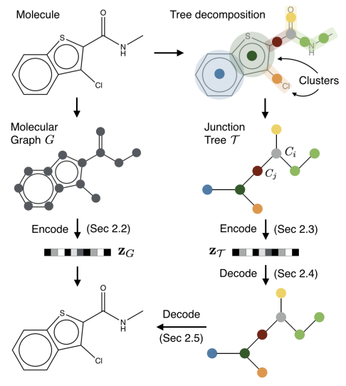
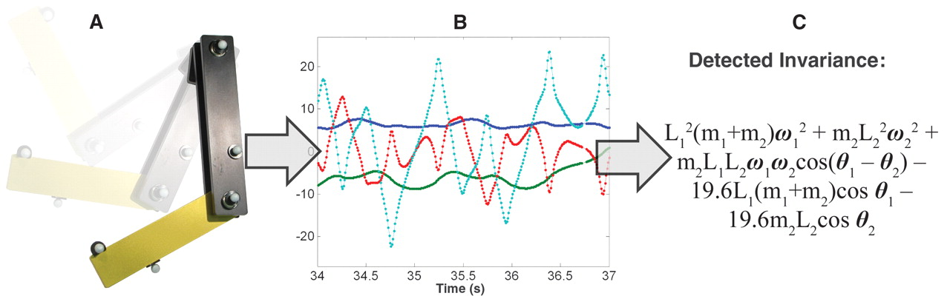
Nonlinear regression
Infer networks
Control dynamical systems
Statistical tests for
time series
Learn fundamental laws of a dataset
Regression over graphs

Slide 49
Tasks
Start with document: docs/logistic-regression.html
Can open an interactive workbook in R: 09-logistic-regression-gaussian-processes
In Section 3.1 we use linear regression to analyse Arabidopsis thaliana gene expression time series data following inoculation with the necrotrophic fungus Botrytis cinerea

Slide 50
Tasks
Start with document: docs/logistic-regression.html
Can open an interactive workbook in R: 09-logistic-regression-gaussian-processes
In Section 3.1 we use linear regression to analyse Arabidopsis thaliana gene expression time series data following inoculation with the necrotrophic fungus Botrytis cinerea
Fit linear regression model
Predict values at new locations
Fit more complex models
Use sum squared errors on held out data to identify the best model

Slide 51
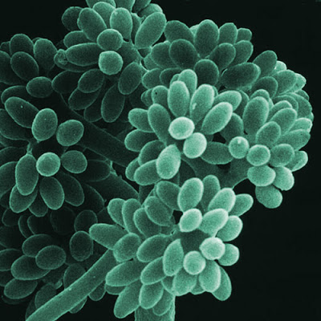
Tasks
As well as measuring gene expression we also have a measure of infection status (binary data)
Use logistic regression to look for marker genes that are indicative of infection status (Section 1.2)
Main task: As before the main task is to use logistic regression to identify marker genes predictive of infection status.

Slide 52
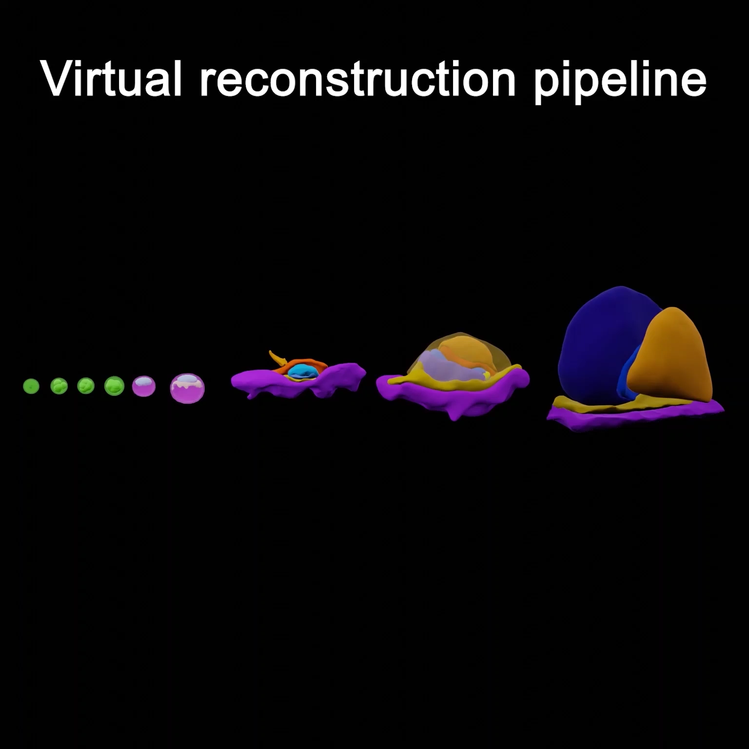
Virtual embryo reconstruction
Bergmann, Penfold, Slatery et al. (Nature, in press)

Slide 53
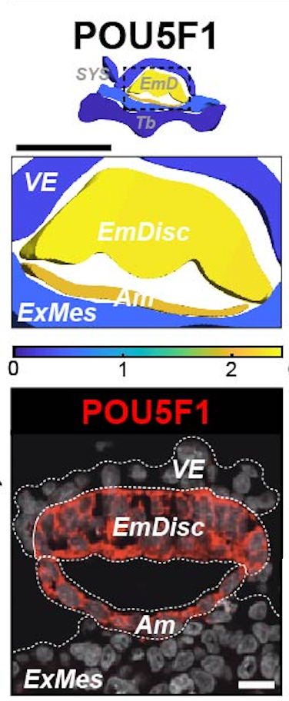
Spatial transcriptomics
=v
Interpolate from discrete samples
Bergmann, Penfold, Slatery et al. (Nature, in press)

Slide 54
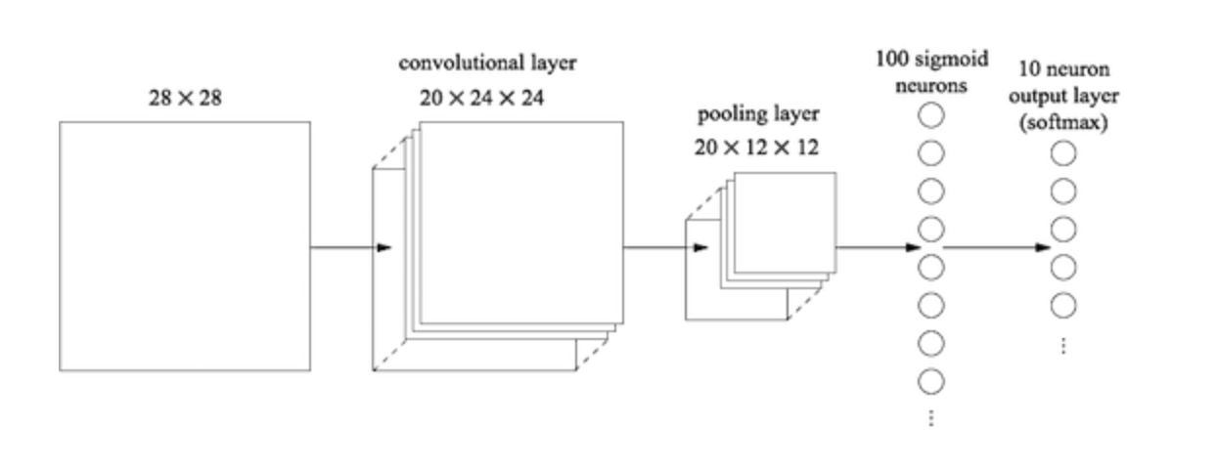
Multilayer neural networks

Slide 55
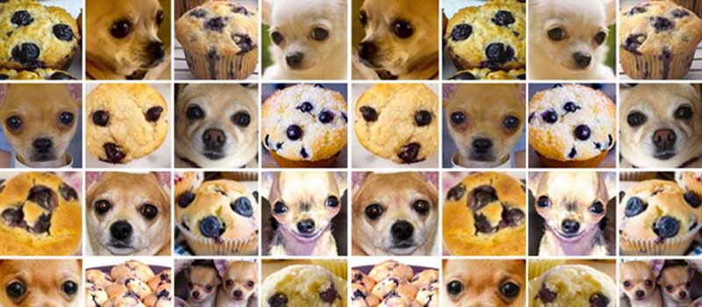
Introduction to multilayer neural networks
Introduce you to the basics of neural networks and multilayer neural networks (MLNNs) aka “deep learning”
Cover basic terminology
Highlight some limitations of MLNNs
Construct some basic neural networks for regression and image analysis
#ChihuahuaOrMuffin

Slide 56
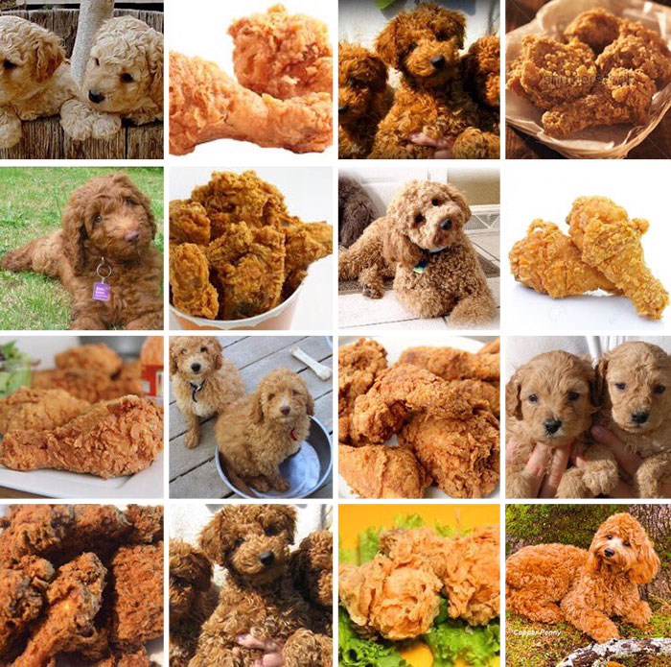
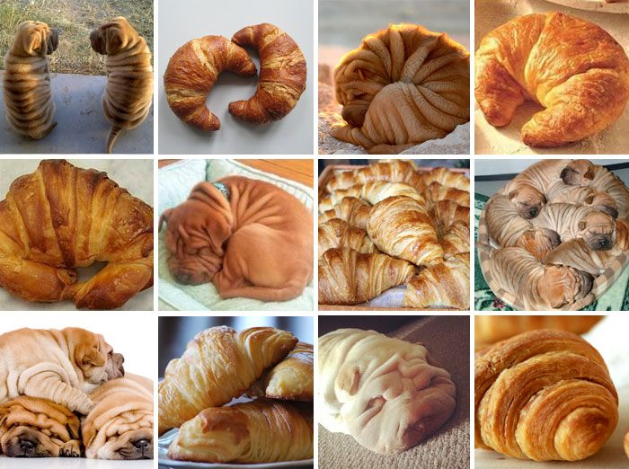

Introduction to multilayer neural networks
#LabradoodleOrFriedChicken
#SharPeiOrCroissant

Slide 57
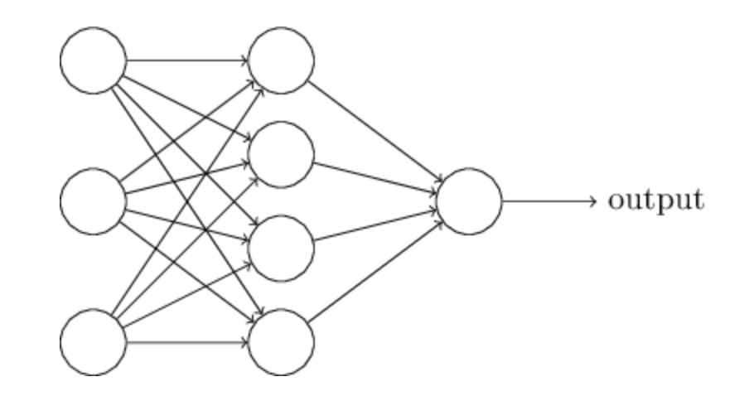
Neural networks
Input
Hidden
Output
Example: 3-input nodes = 3D input
1-output nodes = 1D input
(Nielsen, Neural networks and deep learning)
Neural network: Input nodes → one hidden layer nodes → output nodes

Slide 58
Neural networks

Slide 59
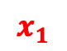
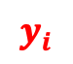
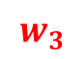

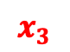

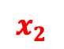
Neural networks
$$x_{1}$$
$$w_{1}$$
$$x_{2}$$
$$w_{2}$$
$$y_{i}$$
$$w_{3}$$
$$x_{3}$$
$$y_{i}=w_{1}x_{1}+w_{2}x_{2}+w_{3}x_{3}+bias$$

Slide 60






Neural networks
$$x_{1}$$
$$w_{1}$$
$$x_{2}$$
$$w_{2}$$
$$y_{i}$$
$$w_{3}$$
$$x_{3}$$
$$y_{i}=w_{1}x_{1}+w_{2}x_{2}+w_{3}x_{3}+bias$$
$$y_{i}=f(w_{1}x_{1}+w_{2}x_{2}+w_{3}x_{3}+bias)$$

Slide 61

Neural networks
$$w_{1}$$
$$w_{2}$$
$$y_{i}$$
$$w_{3}$$
$$y_{i}=w_{1}x_{1}+w_{2}x_{2}+w_{3}x_{3}+bias$$
Hidden layers are essentially representing different projections/representations of the input
$$y_{i}=f(w_{1}x_{1}+w_{2}x_{2}+w_{3}x_{3}+bias)$$

Slide 62
Neural networks
Final layer then combines these various representation
How this final layer is activated will determine the task: linear for regression and sigmoid for binary classification

Slide 63
Neural networks
Can calculate a loss function with respect to the various parameters (backpropagation)

Slide 64
Neural networks
CODE (keras in R)
mod <- keras_model_sequential() %>%
layer_flatten(input_shape = c(1,3)) %>%
layer_dense(units = 4, activation = "relu")
layer_dense(1, activation = ”sigmoid")
activation="sigmoid")
Neural network: Input nodes → one hidden layer nodes → output nodes
activation="linear")

Slide 65


28x28 pixels
(Nielsen, Neural networks and deep learning)
Slightly more realistic neural network: digit classification (0 – 9)

Slide 66

Multilayer Neural networks
(Nielsen, Neural networks and deep learning)

Slide 67
Multilayer Neural networks
(Nielsen, Neural networks and deep learning)

Slide 68
Multilayer Neural networks
CODE
mod <- keras_model_sequential() %>%
layer_flatten(input_shape = c(1,8)) %>%
layer_dense(units = 9, activation = "relu") %>%
layer_dense(units = 9, activation = "relu") %>%
layer_dense(units = 9, activation = "relu") %>%
layer_dense(4, activation = ”sigmoid")

Slide 69
Multilayer Neural networks
 | Activation | Loss | Metrics
Binary (0/1) | Sigmoid | binary_crossentropy | binary_accuracy
Multiclass/multilabel (0/1),(0/1) | sigmoid | binary_crossentropy | binary_accuracy
Categorical (0/1/2/3) | softmax | categorical_crossentropy | categorical_accuracy
Continuous (regression) | linear, none, others | mean_squared_error | mean_squared_error

Slide 70

Multilayer Neural networks
Lots of parameters
Accurate MLNNs use a lot of data. I mean A LOT!
Difficult to do all at once
Use stochastic gradient descent (process smaller sets of data at a time)
Minibatch size: number of input samples to used in stochastic gradient descent (optimiser)
Epoch: one full sweep through all minibatches
Loss function?
Minibatch
All data

Slide 71

https://towardsdatascience.com/

Slide 72
Convolutional neural networks
(Nielsen, Neural networks and deep learning)

Slide 73


Convolutional neural networks
(Nielsen, Neural networks and deep learning)
Image (set of pixels)
Convolution layer
Scans across the image using a filter to create a feature map

Slide 74

Convolutional neural networks
Image (set of pixels)
Convolution layer
Scans across the image using a filter to create a feature map

Slide 75

Convolutional neural networks
https://adeshpande3.github.io/A-Beginner%27s-Guide-To-Understanding-Convolutional-Neural-Networks/

Slide 76


Convolutional neural networks
https://adeshpande3.github.io/A-Beginner%27s-Guide-To-Understanding-Convolutional-Neural-Networks/

Slide 77

Convolutional neurual networks
https://adeshpande3.github.io/A-Beginner%27s-Guide-To-Understanding-Convolutional-Neural-Networks/

Slide 78

Convolutional neurual networks
Usually want to learn more than one feature map
CODE
mod$add(Conv2D(filters = 3, kernel_size = c(4, 4),input_shape = c(28,28,3)))

Slide 79


Pooling layers
CODE
mod$add(MaxPooling2D(pool_size=c(2, 2)))

Slide 80

Convolutional neural networks
Human?
Fab hair?

Slide 81

Convolutional neural networks
Human?
Fab hair?

Slide 82

Convolutional neural networks
Human?
Fab hair?

Slide 83
Convolutional neural networks
Human?
Fab hair?

Slide 84
Convolutional neural networks
Human?
Fab hair?

Slide 85
Convolutional neural networks
Human?
Fab hair?

Slide 86
Convolutional neural networks
Human?
Fab hair?

Slide 87


Task
Implement a convolutional neural network that can recognise images of Rick Sanchez vs from the TV series Rick & Morty
Data from https://masterofallscience.com
Understand the basic parameters
Compare different network architectures … don’t just use the default architecture try changing it. Let’s see who can get the best performance
Compare your model to the earlier ANN.

Slide 88
Predictive features?
DeepExplain
(python)
A demo python script can be found in Python subfolder

Slide 89
Predictive features?

Slide 90
Predictive features?

Slide 92
CODE
mod$add(Conv2Dtranspose(filters = 3, kernel_size = c(4, 4))
mod$add(UpSampling2D(size=c(2,2)))

Slide 93

CNN
Dinosaur?
Piglet?
Input
Compressed representation

Slide 94
Upscaling/Generators
High res. output
Low res. Input or noise

Slide 95
Autoencoders
Input
Output
Compressed representation

Slide 96
Autoencoders - denoising
Noisy input
Clean output

Slide 97

Autoencoders - transformations
Inputs
High res. output

Slide 98


Variational autoencoders
Rampášek et al.
Jin et al
Notes:
Rampášek

Slide 99

Generative Adversarial Networks
CNN
Image credit: Thalles Silva

Slide 100
Split data: test / validation / prediction
Architecture of CNN and other types of network still an area of active research
When in doubt don’t be a hero look at the best performing architectures and borrow them (transfer learning)
Some of the best image classifiers use millions of images
Do you have millions of data points?
Can do a reasonable job with 10k images
Rule of thumb: at least 1000 images per class
Augment your data!
Inherent biases in datasets

Slide 101


Split data: test / validation / prediction
Architecture of CNN and other types of network still an area of active research
When in doubt don’t be a hero look at the best performing architectures and borrow them (transfer learning)
Some of the best image classifiers use millions of images
Do you have millions of data points?
Can do a reasonable job with 10k images
Rule of thumb: at least 1000 images per class
Augment your data!
Inherent biases in datasets

Slide 103
PULSE: Self-Supervised Photo Upsampling via Latent Space Exploration of Generative Models

Slide 105
Generative Pre-trained Transformer 2 (GPT-2) is an AI developed by OpenAI in February 2019. GPT-2 uses deep learning to translate text, answer questions, summarise passages and generate text output

Slide 106

Generative Pre-trained Transformer 2 (GPT-2) is an AI developed by OpenAI in February 2019. GPT-2 uses deep learning to translate text, answer questions, summarise passages and generate text output
Final task: You’ve learned about some of the various basic methods in ML/AI now go read about bias in AI and ML / ethical AI
Table from Sheng et al. (2019)

Slide 107
Tasks
Start with document: docs/logistic-regression.html
Can open an interactive workbook in R: 09-logistic-regression-gaussian-processes
In Section 3.1 we use linear regression to analyse Arabidopsis thaliana gene expression time series data following inoculation with the necrotrophic fungus Botrytis cinerea

Slide 108
Tasks
Start with document: docs/logistic-regression.html
Can open an interactive workbook in R: 09-logistic-regression-gaussian-processes
In Section 3.1 we use linear regression to analyse Arabidopsis thaliana gene expression time series data following inoculation with the necrotrophic fungus Botrytis cinerea
Fit linear regression model
Predict values at new locations
Fit more complex models
Use sum squared errors on held out data to identify the best model

Slide 109
Tasks
As well as measuring gene expression we also have a measure of infection status (binary data)
Use logistic regression to look for marker genes that are indicative of infection status (Section 1.2)
Main task: As before the main task is to use logistic regression to identify marker genes predictive of infection status. How would you write this up?

Slide 110
`
Multiple explanatory variables

Slide 111
`
Multiple explanatory variables

Slide 112
`
Multiple explanatory variables

Slide 113
`
Multiple explanatory variables
SSE
m₂
m₁
z = m₁ x + m₂ y + c

Slide 114
`
Multiple explanatory variables
SSE
m₂
m₁
z = m₁ x + m₂ y + c

Slide 115
Logistic regression
Model the probability of success using a logistic function

Slide 116

Logistic regression
Model log odds as liner model:
Solve for x
Likelihood
)
Using held out data find parameters that maximises this
likelihood

Slide 117
Logistic regression
Likelihood
)

Slide 118

Training set/test set
What if my dataset is small?
Leave one out cross validation

Slide 119
Logistic regression
Likelihood
)
P(y_{i}=1) = 0.51

Slide 120
Logistic regression
Likelihood
)
P(y_{i}=1) = 0.91

Slide 121
Logistic regression
Likelihood
)
P(y_{i}=1) = 0.91
x = (x₁, x₂, x₃, …, x_{n-1}, x_{n})
y = (0, 0, 1, …, 1, 1)
L = p(y₁=0) x p(y₂=0) x p(y₃=1) x … x p(y_{n}=1) x p(y_{n}=1 )
Give and value of beta0 and beta1 what’s the probability we see the sequence of data y = (y₁,…,y_{n})

